Slide 1

Inheritance
CitiusTech has prepared the content contained in this document based on information and knowledge that it reasonably believes to be reliable. Any recipient may rely on the contents of this document at its own risk and CitiusTech shall not be responsible for any error and/or omission in the preparation of this document. The use of any third party reference should not be regarded as an indication of an endorsement, an affiliation or the existence of any other kind of relationship between CitiusTech and such third party

Slide 2
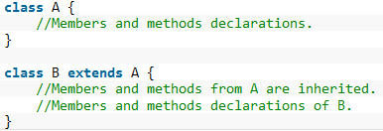
Inheritance is one of the most important feature of object oriented programming.
We can create hierarchical classification .
Reusability of code.
We can use “extends” keyword to inherit a class.
types of inheritance .
Note :We can access super class member with the object of sub class except private member.

Slide 3
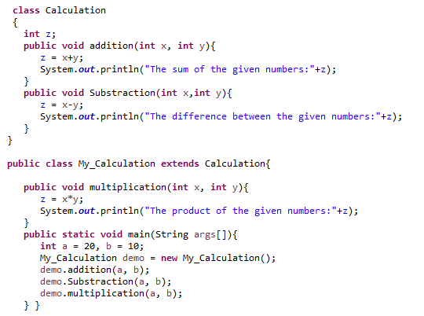
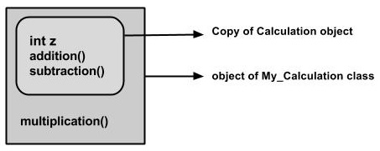

Slide 4
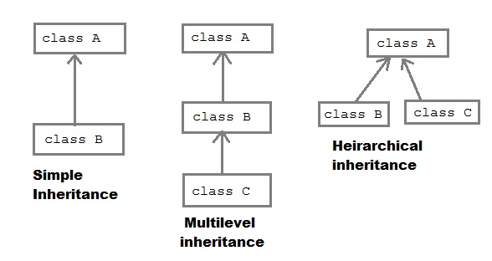
Type of inheritance

Slide 5
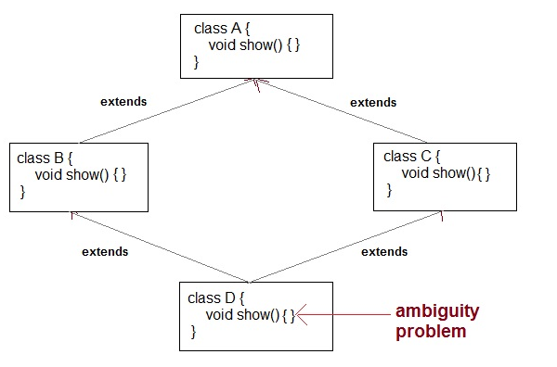
multiple inheritance is not supported in Java

Slide 6
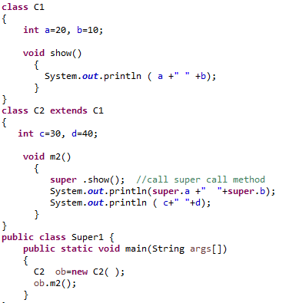
Super keyword
Super can be use in two forms
To access the super class member (data & function).
To call the super class constructor.

Slide 7
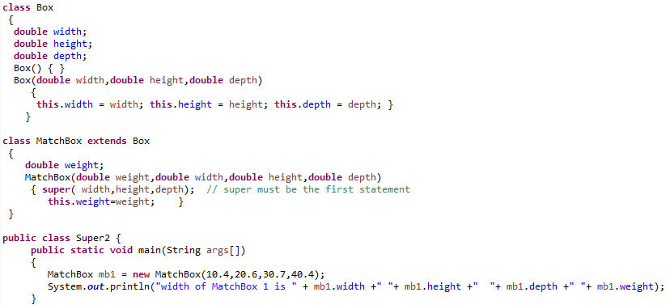

Slide 8
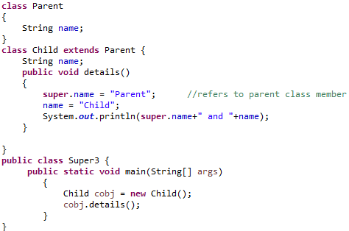
To access the super class member that has been hidden by member of subclass.

Slide 9
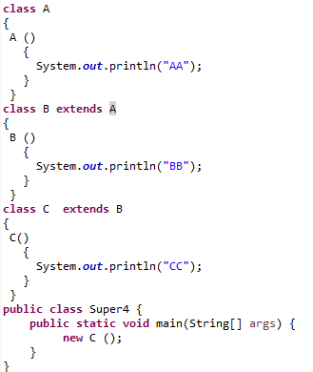
Default super () - constructors are called in order of derivation

Slide 10
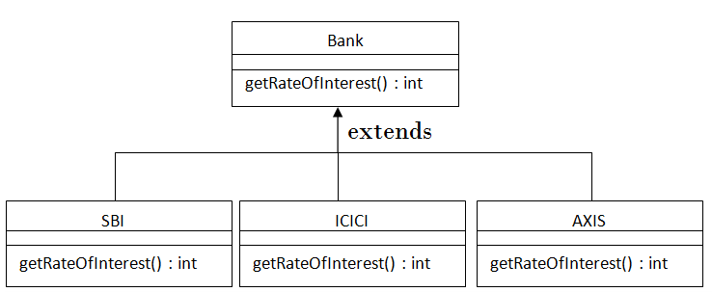
Method Overriding
When a method in a subclass has the same name and type signature as a method in super class , is said to be override the method of super class.
Subclass provides the specific implementation of the method that has been provided by one of its parent class.
Method overriding is used for runtime polymorphism

Slide 11
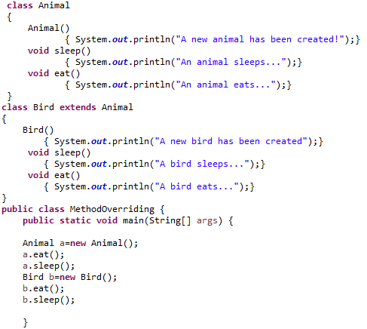

Slide 12
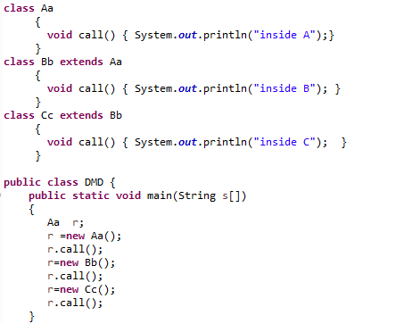
Dynamic method dispatch
A call to an overridden method is resolve at run time rather than compile time also known as runtime polymorphism.

Slide 13
Abstract class
In some situation we want a super class that declares the structure without providing complete implementation of every method. These methods will be implemented by sub classes by overriding.
Class with abstract method must be declared as abstract and object of this class can’t be created.
abstract class Shape
{
int l ,b;
abstract void calArea();
}
class Tri extends Shape
{
void calArea()
{
System.out.println(“Area for tri”)
}
}
class Rec extends Shape
{
void callArea()
{
System.out.println(“Area for Rec”)
}
}
class Test
{
public static void main(String s[])
{
Shape s;
s=new Tri();
s.calArea();
s=new Rec();
s.calArea();
}
}

Slide 14
Interface
By using interface we can fully abstract the class.
Interface can have abstract methods only.
Data member in interface are static & final.
interface Abc
{
int i=10;
void m1();
void m2();
void m3();
void m3();
}
class Test implements Bbc
{
void m1()
{
System.out.println(“m1);
}
void m2()
{
System.out.println(“m2);
}
void m3()
{
System.out.println(“m3);
}
void m4()
{
System.out.println(“m4);
}

Slide 15
class Eg
{
public static void main(String s[])
{
Bbc ref;
ref=new Test();
ref.m1();
ref.m2();
ref.m3();
ref.m4();
}
}

Slide 16
Object Class
Every class in Java implicitly extends Object.
Object type variables can refer to objects of any type:
Example:
Object obj = new Emp();
Object Class Methods:

